Slide 1
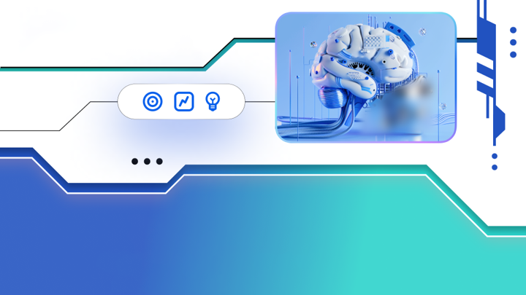

Slide 2
Mission
We help e-commerce businesses
grow, expand, & scale.
We use AI to simplify and automate marketing & advertising tasks.
We provide tracking tools & integrations with affiliates to boost sales.

Slide 3
Challenges You Face
Creating and optimizing campaigns manually.
Setting up and analyzing experiments takes time.
Using multiple tools and managing lots of data.
Teams working in isolation with fragmented information.
Analyzing campaigns across different platforms
Delegating tasks and managing workflows.

Slide 4
AI-driven Marketing
Personalization
Programmatic Advertising
More personalized and relevant content for each consumer.
Improves ad buying precision, showing more relevant ads to consumers.
Data Analysis
SEM Optimization
Analyze large amounts of data quickly, leading to better decisions.
Automate and improve search engine marketing practices.
Content Creation
Market Insights
Create diverse content like blogs and social media posts, saving time.
Insights into market trends and consumer behavior.

Slide 5
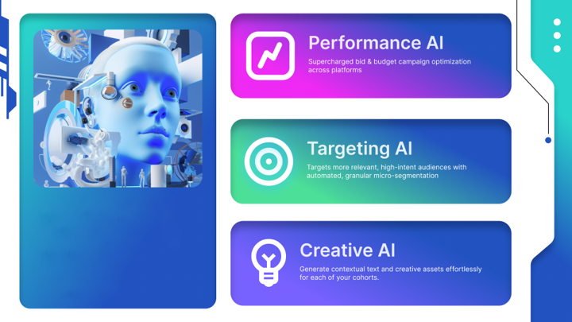
Performance AI
Set the perfect budget and prices for your ads
Targeting AI
Find the right people to see your ads
Our AI platform: MobiBox
Creative AI
Create high-quality ad content and assests

Slide 6
Performance AI
Set the perfect budget and prices for your ads
Real-time Bid & Budget Improvements: Automatically adjusts your campaign spending in real-time for the best results.
Cross-platform Monitoring: Keeps an eye on your spending across platforms like Google, Facebook, and TikTok.
Budget Redistribution: Moves your budget to the best-performing channels automatically.
Engagement Scoring: Analyzes audience engagement to optimize campaigns for better results.
16M
24%
35%
60+
Actual Actions
Taken
Improvement in
CTR
Increase in
ROAS
Custom Tactics
Created

Slide 7
Targeting AI
Find the right people to see your ads
Smart Audience Creation: Automatically finds the best audiences for your ads across different platforms.
Theme Recommendations: Suggests the best themes for your campaigns to attract the right customers.
LTV-based Targeting: Fine-tunes your audience targeting based on customer lifetime value.
Discovering New Audiences: Finds new potential customers you might have missed.
CRM Data Integration: Uses your existing customer data from existing campaigns and conversion patterns to improve targeting.
Audience Insights: Provides reports on which audiences are interacting with your ads, helping you refine your strategy.
20K
98+
24k+
96%
Personas
Created
Average Relevancy
Score
Look-Alike Audience
Generated
Accurate on average

Slide 8
Creative AI
Create high-quality ad content and assests
Performance-based Asset Rotation: Automatically updates ad images and videos based on performance for better results.
Message Clarity Scoring: Analyzes ad copy ensuring it is clear and effective.
Intelligent Creative Sequencing: Arranges the order in which your ads are displayed for maximum impact.
Auto-segmentation of Creatives: Automatically segments and matches creatives to different audience groups.
Personalized Test Generator: Creates tailored test ads for various customer segments.
High-quality Asset Generation: Quickly generates high-quality videos and images, reducing turnaround time.
Smart Creative Resizer: Adjusts creative sizes for different platforms.
1M+
99+
95%
96%
Creatives
Generated
Message
Clarity Score
Lookalike
Audience
Generated
Ideal Logo
Placement

Slide 9
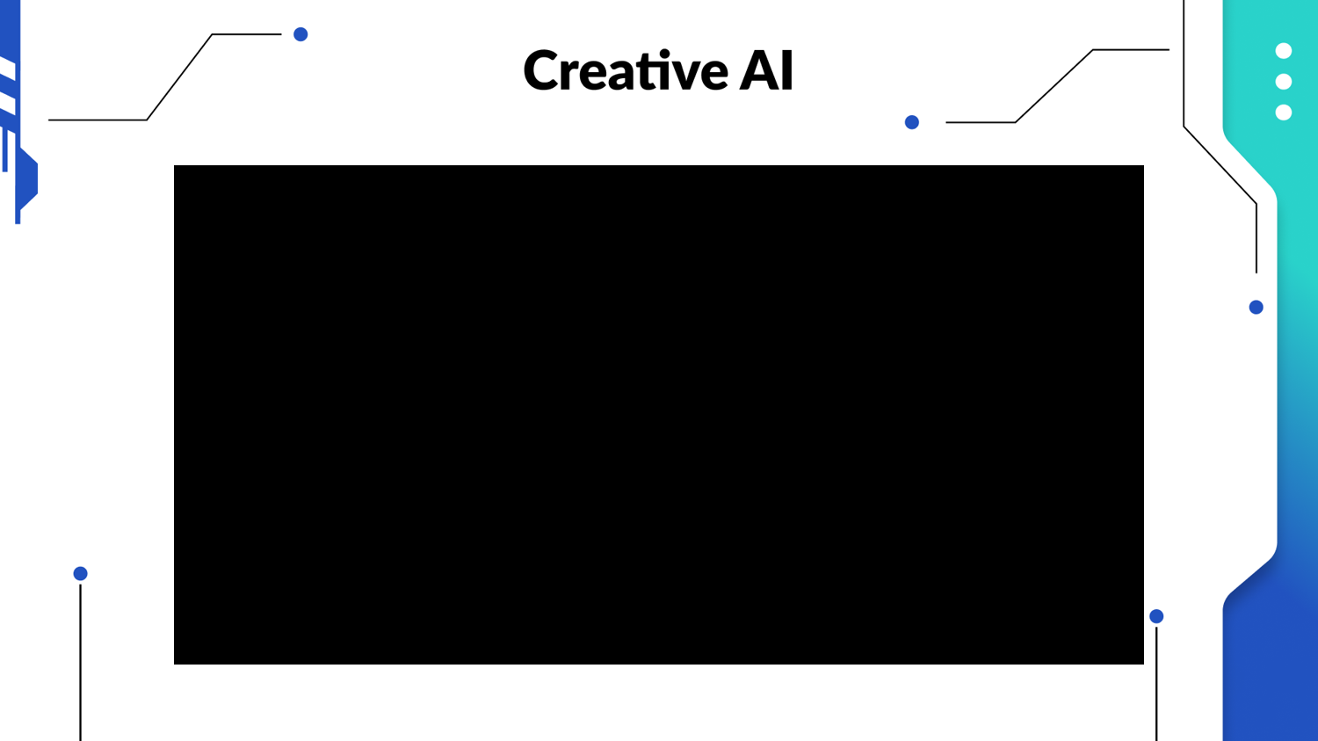
Creative AI Demo

Slide 10
Supercharge Your E-commerce Sales with MobiBox & Shopify
Effortless Affiliate Tracking
Boost Sales & Growth
No Technical Expertise Needed
MobiBox integrates with your Shopify store, allowing you to track affiliate campaigns and their impact on sales.
With clear insights into affiliate performance, you can expand your partner network and drive sales.
Our platform removes technical barriers, making MobiBox and Shopify integration accessible to all store owners.

Slide 11
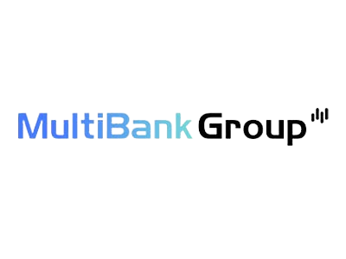
What Makes MobiBox Unique?
Gets you the results you want from your marketing (e.g., more sales).
Helps you plan your marketing campaigns for success.
Provides 24/7 support from experts.
Has a dedicated team to assist you anywhere in the world.
Gives you access to easy-to-use tracking tools.
Lets you manage your marketing across different platforms.
Brands That Trust Our Technology

Slide 12
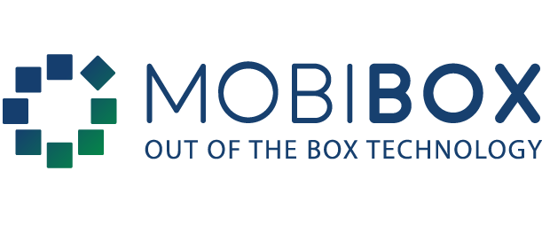
THANK
YOU

